Slide 1

BlockGeeks Training Program
Tech Mahindra 25th October 2018

Slide 2
Why Blockchain ?
Blockchain solutions can eliminate huge amounts of cost, redundancy, error and needless reconciliation across entire business ecosystems, as well as opening up previously hidden or new revenue opportunities
It builds trust through Transparency : Making sure ‘what I see is what you see’
It will move the world from inconsistent, isolated, and custom IT infrastructure to a shared business logic, securely shared data and common processes

Slide 3
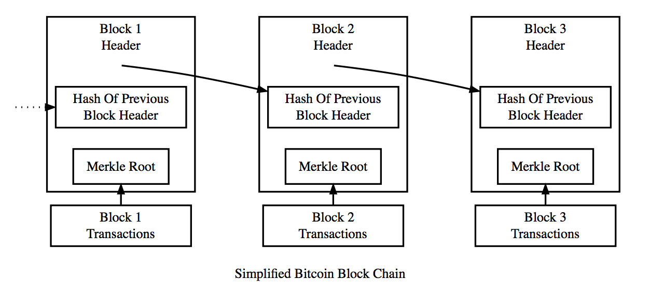
Key Components - Blockchain
Blockchain – It’s an online distributed ledger that keeps track of all transactions, creating a dynamic chain of inter connected blocks that store valuable information
Smart Contract
Reduces time and cost
Shared Ledger
Encrypted
Records
Brings Transparency and immutability
Privacy
Consensus
Reduces Risk
Traditional Distributed Databases
Portions of data are distributed on network
Distributed Ledger Databases
Complete ledger is distributed on network.
Secure
Builds trust

Slide 4
Schematic Process Flow of Blockchain
N
N
Block of 2 transactions
Transaction 1
Transaction 2
S T R
S T R
➔
➔
S T R
S T R
N
Block gets broadcasted to the network for validation
N
N
Consensus based Transaction Authentication through network of nodes(N)
S: Sender
T:
Transaction $$ Value
R:
Receiver
N
N
S T R
S T R
Hash Key : Cryptographic Digital Signature.
Hash key of previous block referred to in current block
S T R
S T R
➔
N
S T R
S T R
N
N
Consensus based Block Validation
Blockchain
4

Slide 5
What Blockchain is?
The combination of distributed database, encryption, consensus and smart contracts brings unique capability to blockchain.
A blockchain is
Application Server: It hosts business logic and ensures it runs at the right time and for the right reasons
Messaging Engine: It allows people and, importantly, their computers to exchange information and ensure that the right information gets to the right places in the right order
Workflow Manager: It help coordinate the activity of different parties across time and space to achieve some business outcome.
Database: It a decentralized distributed database enabling single source of truth
Messaging Engine
Application Server
Database
Workflow Manager

Slide 6


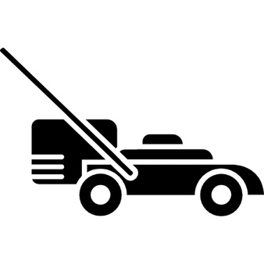

Use Cases with Product Manufacturers
For a global Medical Equipment manufacturer, we are creating a wallet based pay-per-use platform helping drive worldwide sales of expensive capital equipment
For the large coffee machine manufacturer, we are creating a single source of truth for manufacturer, supplier, Third Party Labs and inspection on compliance documentation
For the largest lawn mover manufacturer, we are creating a blockchain based product registry that connects with the warranty systems across Europe and USA
For an Indian automotive manufacturer, we are creating a vehicle lifecycle management solution on blockchain that connects across the ecosystem of Dept. of Motor Vehicles, Service agents, Dealers, Banks, Insurance, etc

Slide 7
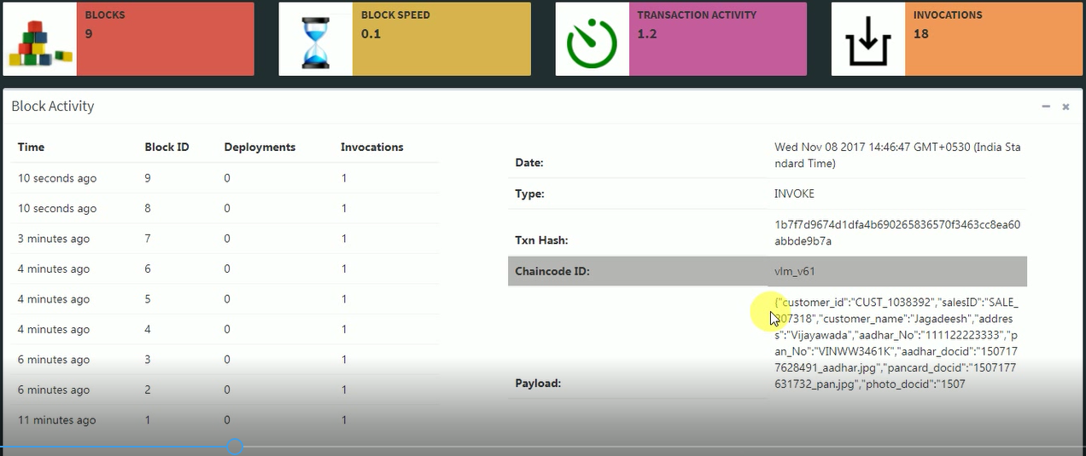
Blockchain- Administrator View
The below screenshot shows an RTA or administrator view of Blockchain for Vehicle Lifecycle Management
Data in the Block

Slide 8
Types of Blockchain
Consortia Blockchain
Private Blockchain
(Permissioned)
Public Blockchain
(Permissionless)
Network Access
Authorized access , the read and write permissions for blockchain are restricted
Open access, Everybody can download a copy of blockchain ledger
Rules
Follow KYC norms, Anti Money Laundering/ CFT norms due to focus on industry level implementation
No censorship or overlooking body, Anonymous transactions, leaves scope for illegal transaction
Network Validation
Government Bodies, Frameworks could be codified- smart contracts, government approved validators group of FIs and Consortiums
Anybody can join the network to become a validator
Applications
Daily transactions in all Financial Institutions
Can use it for developing own blockchain network – Innovation, R&D purpose , used for creating PoC
Accountability
High Degree of Accountability
Risk of a fraudulent consensus

Slide 9


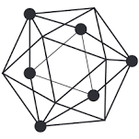

Typical Blockchain Platforms
Public Blockchain
Private Blockchain
Bitcoin
Ethereum
Hyperledger
R3 Corda
The Bitcoin & Ethereum block chain are a shared public ledger on which the entire network relies.
All confirmed transactions are included in the block chain. This way, Bitcoin wallets can calculate the spendable balance and new transactions can be verified to be spending bitcoins that are actually owned by the spender.
The integrity and the chronological order of the block chain are enforced with cryptography.
Hyperledger and Corda are the private permissioned blockchain platform. Corda is specialized for financial industry.
Transactions are confirmed by the parties authorized to do so. The difficulty arises to ensure that all nodes agree upon a common truth, e.g. the correctness of a ledger, as changes made by one node have to be propagated to all other peer nodes in the network.

Slide 10
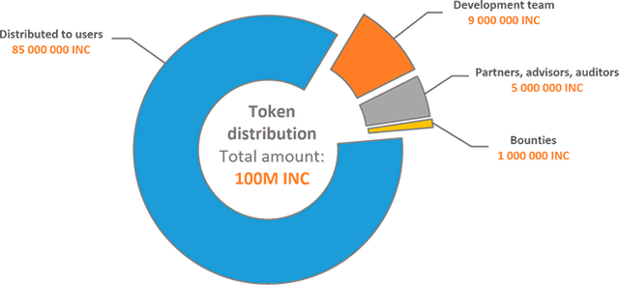
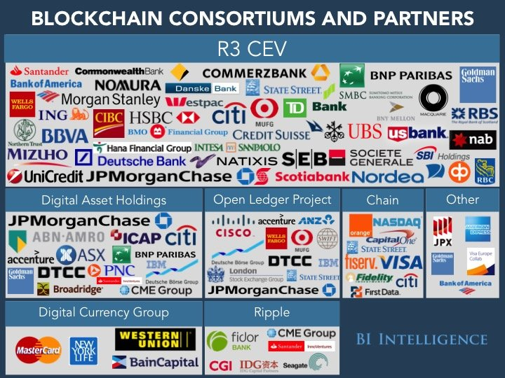
Initial Coin Offering & Consortium
ICO
Consortium
InChain ICO For Insurance Platform
Initial coin offering (ICO) is an unregulated means of crowdfunding via use of cryptocurrency, which can be a source of capital for startup companies.
In an ICO a percentage of the newly issued cryptocurrency is sold to investors in exchange for legal tender or other cryptocurrencies such as Bitcoin.

Slide 11
Problems Blockchain Would NOT Solve
Blockchain is NOT:
Suited for high-performance transactions (milliseconds)
A solution for one participant, i.e., no business network
A replicated database replacement
A messaging solution
A transaction processing replacement
Suited for low-value, high-volume transactions
While Blockchain is seen as technology that would solve a number of business problems, it has its own limitations as well !

Slide 12
